Slide 1


IST 687: Introduction to Data Science
Data Analysis of Hyatt Hotel Group Submitted by: Sanman Yadav, Shubham Bhadouria, James.

Slide 2
Overview
This project required us to analyze the data collected by Hyatt hotels about their various hotel brands and locations, the amenities they provide and the customer data.
Our goal was to analyze the data and identify key factors that contributed towards increasing the Net Promoter Score (NPS) for the group of hotels.
Approach
Formulated Business Questions
Loaded the Data
Cleaned it by removing missing data
Carried out Descriptive and Inferential Statistics on the data
Created Visualization to represent data in an easy to understand format
Constructed models to analyze data & confirm facts obtained from statistical analysis
Devised recommendations and actionable Insights

Slide 3
Business Questions
What amenities provided by the hotel play a major role in influencing likelihood to recommend?
What are the characteristics of the customers that contribute to determining the NPS type?
Which Hyatt hotel brands have the highest number of detractors?
Which booking channel should be prioritized by Hyatt Hotels Group to attract more guests?

Slide 4
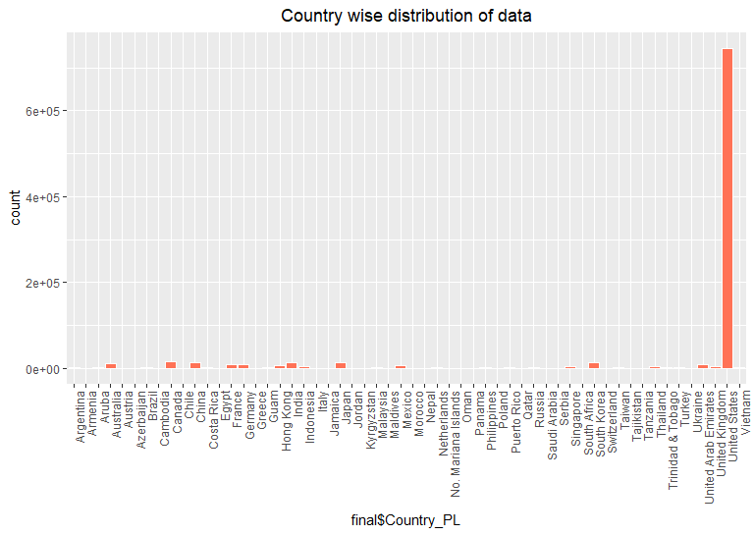
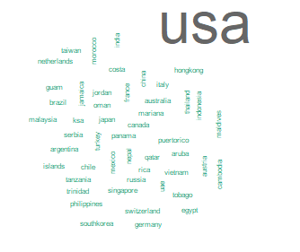
After Cleaning the Data
Total no: of observations: 924,378
Observations from USA: 744,959 (80.59%)
Observations from other countries: 179,419 (19.4%)

Slide 5
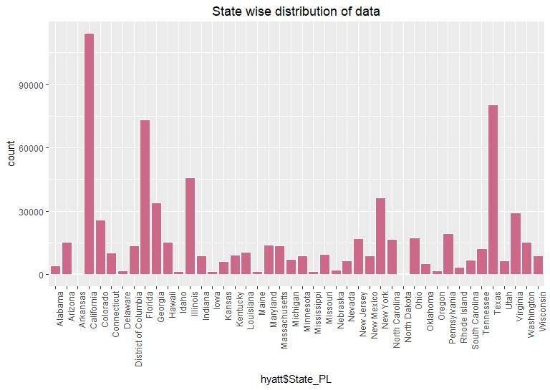
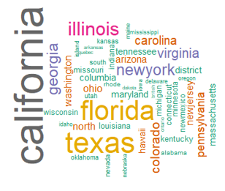
Our Focus of Analysis
No of observations in California State: 114,063 (16.78%)
No of observations from other states: 565,518

Slide 6
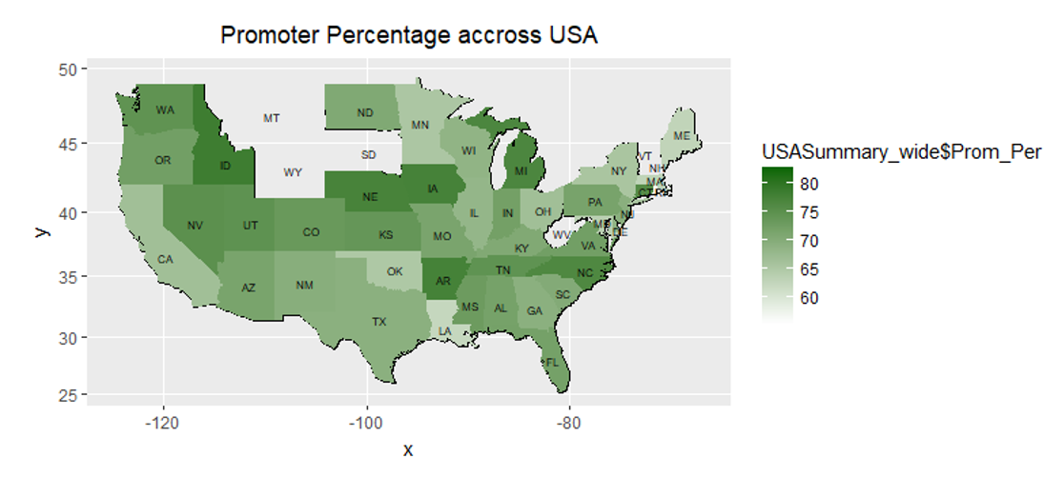
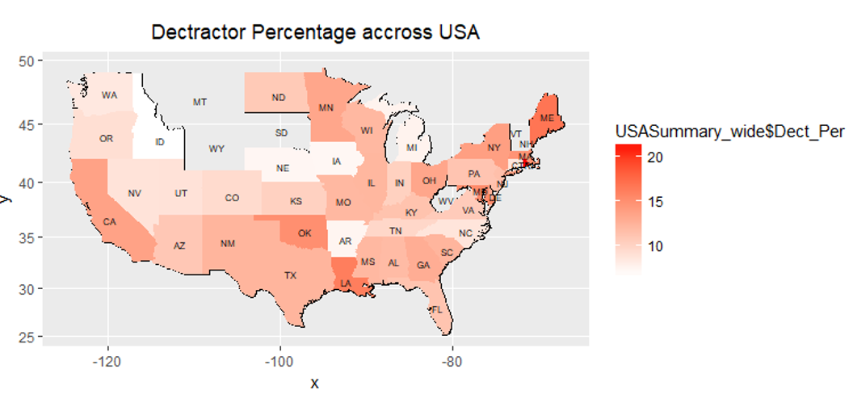
% promoters in California was low as compared to Texas and Florida
% detractors in California was high as compared to Texas and Florida
Hence, we choose California as our focus of analysis

Slide 7
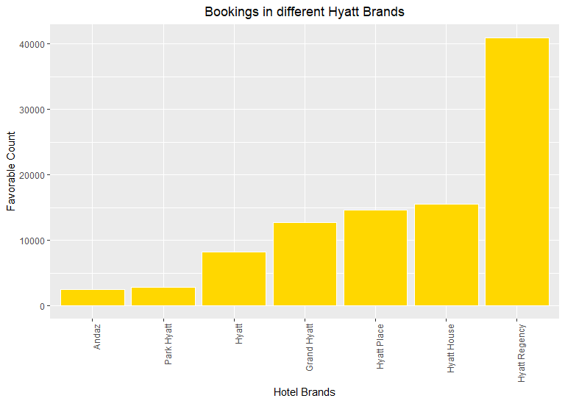
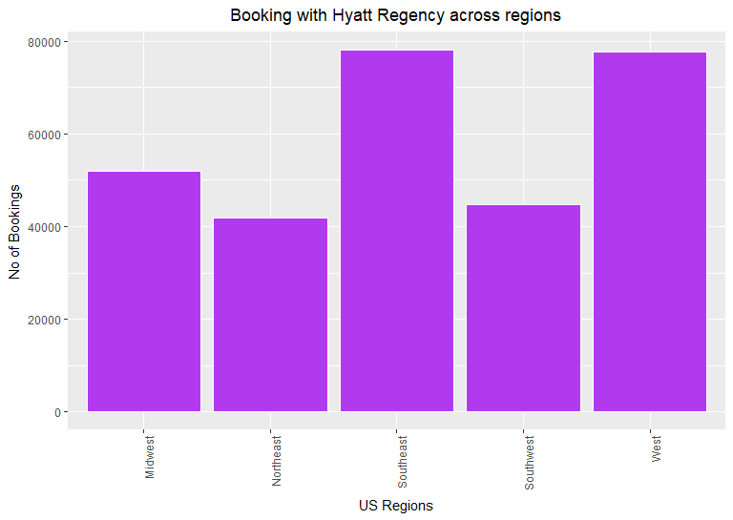
Brand Analysis
To verify the favorability of Hyatt Regency brand

Slide 8
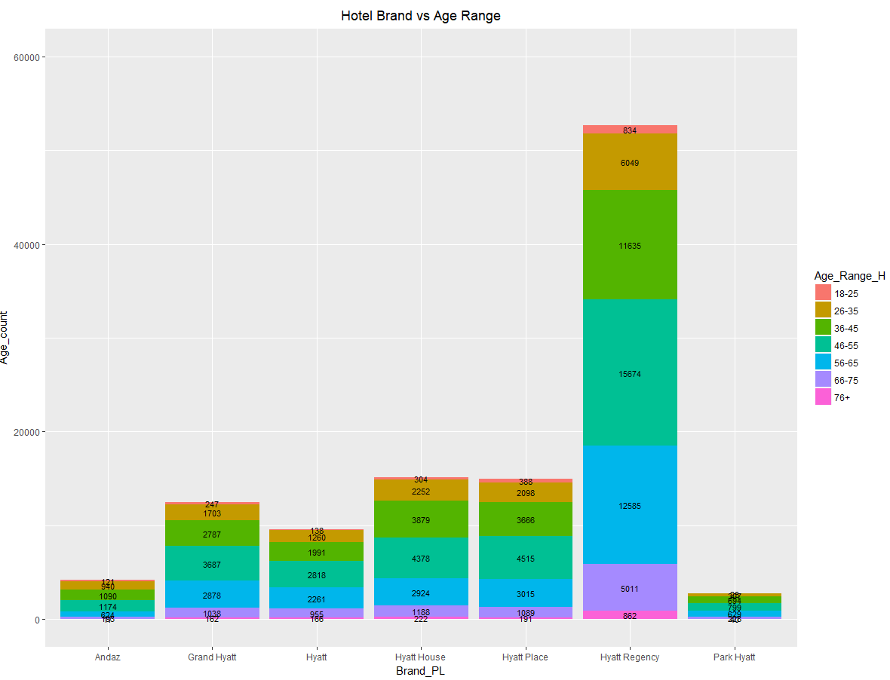
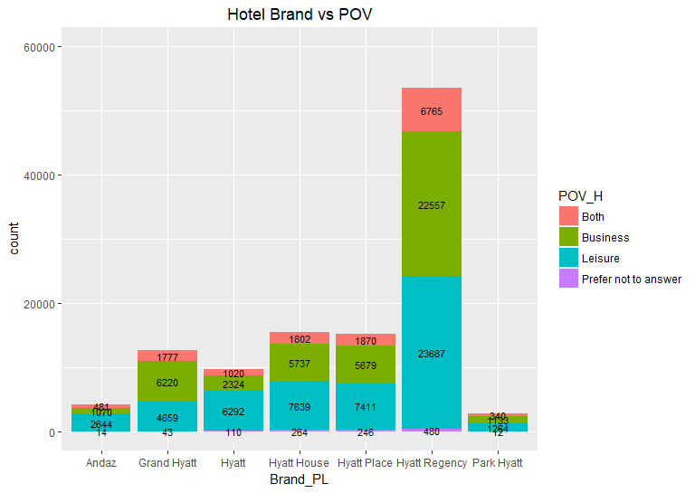
Brand Analysis

Slide 9
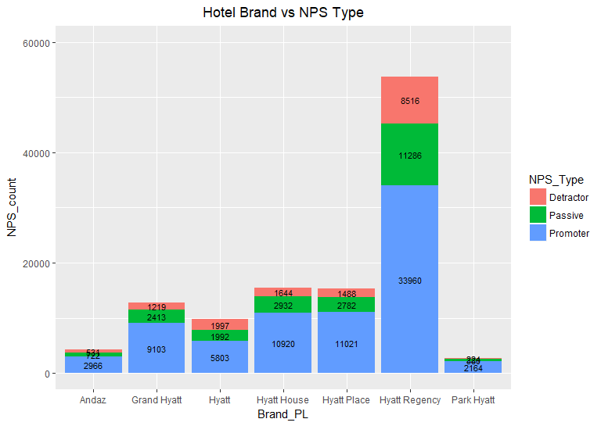
Brand Analysis

Slide 10
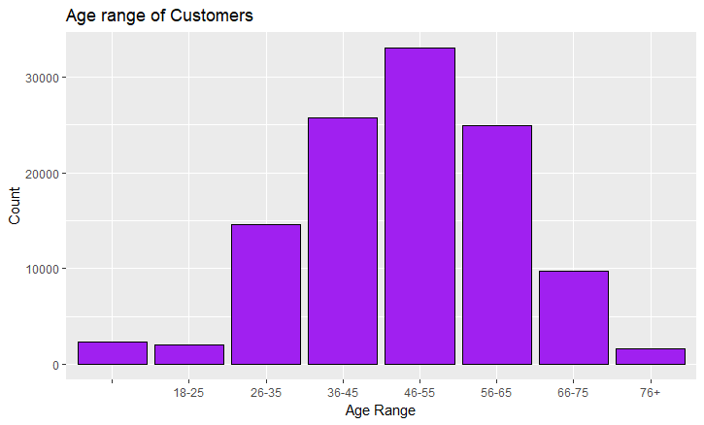
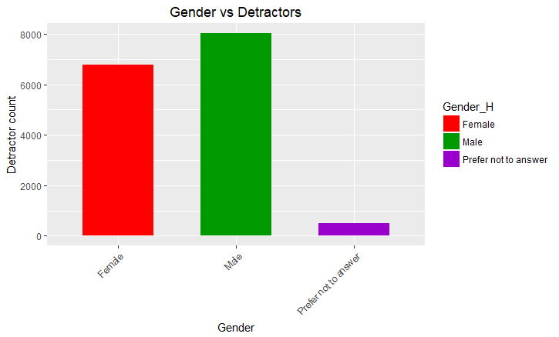
Customer Analysis

Slide 11
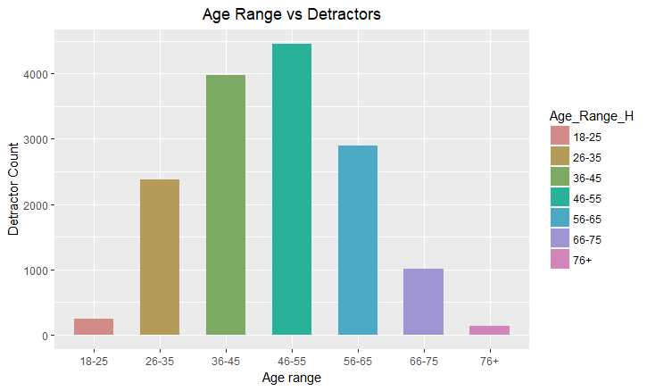
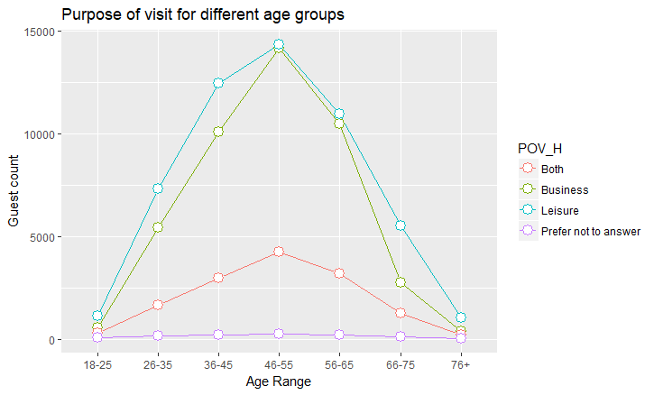
Customer Analysis

Slide 12
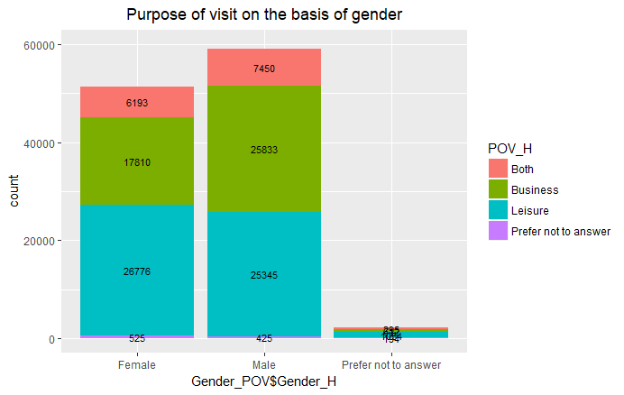
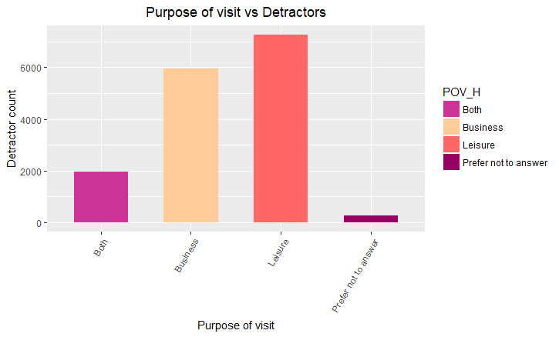
Analyzing Purpose of Visit

Slide 13
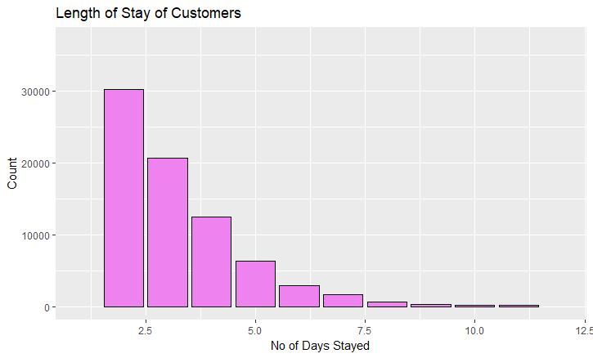
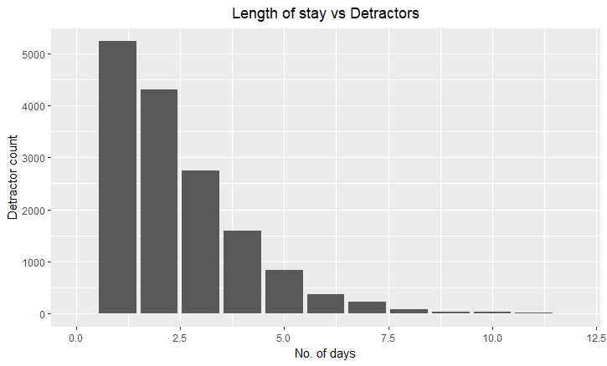
Analyzing Length of Stay

Slide 14
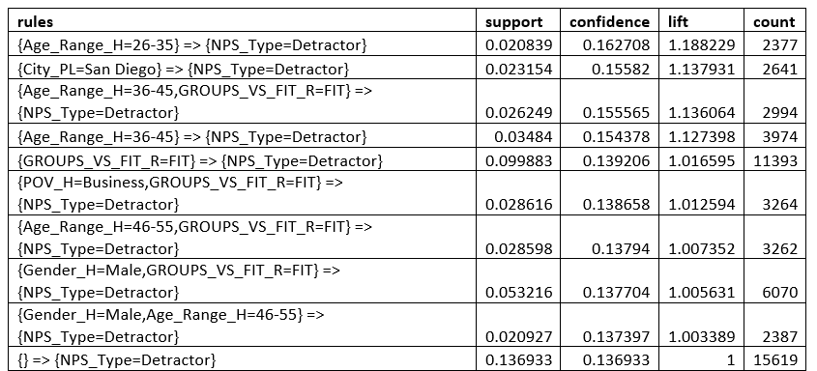







Model Analysis : Association Rule Mining

Slide 15
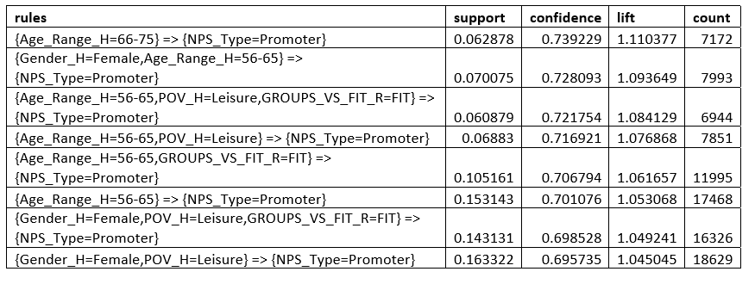









Model Analysis : Association Rule Mining contd…

Slide 16
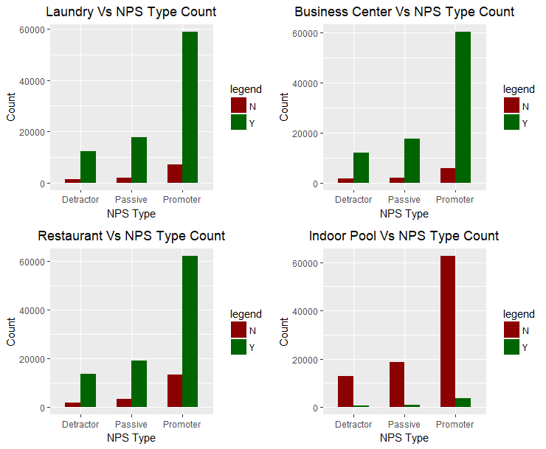
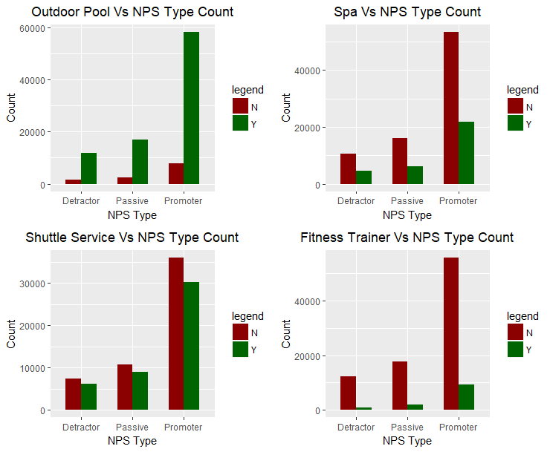
Amenities Analysis

Slide 17
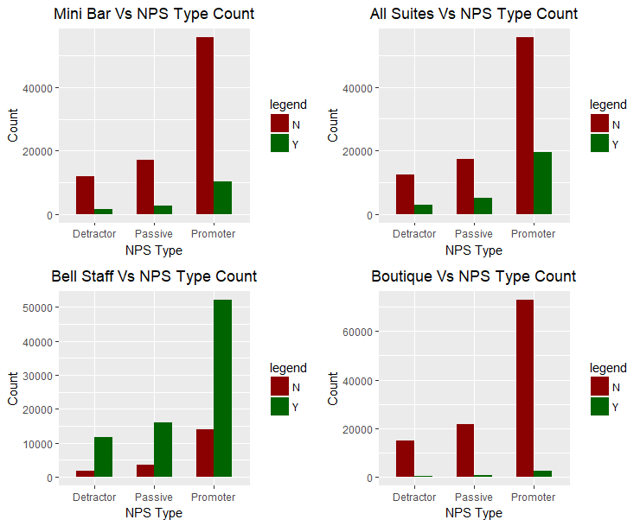
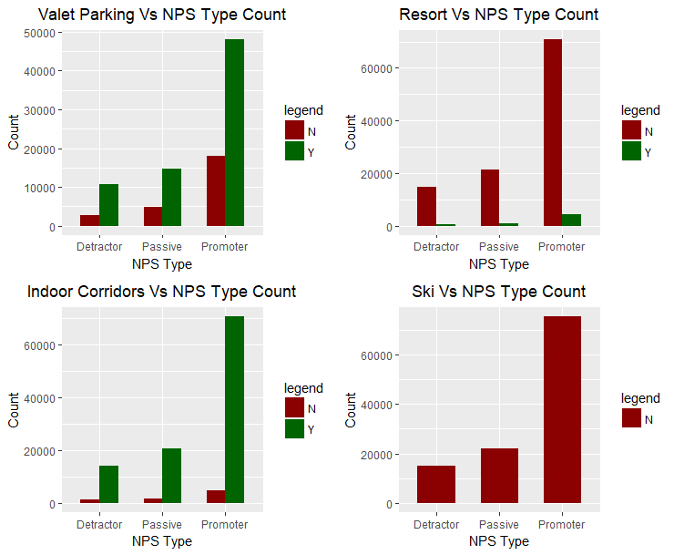
Amenities Analysis contd…..

Slide 18
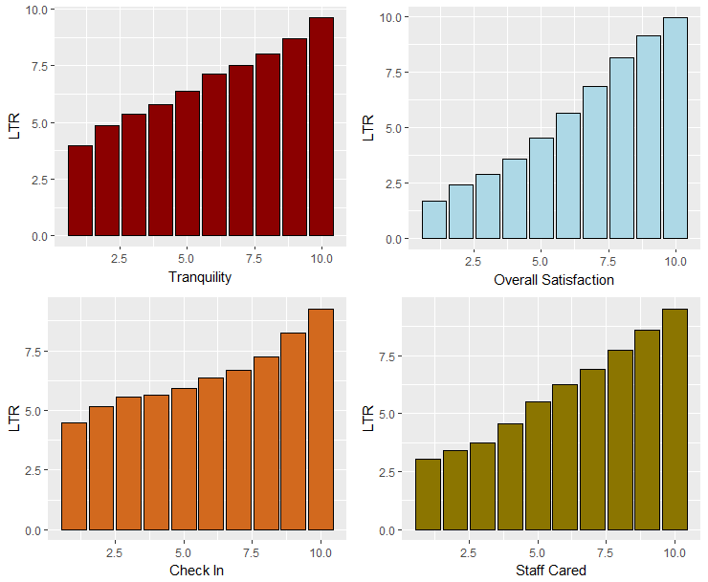
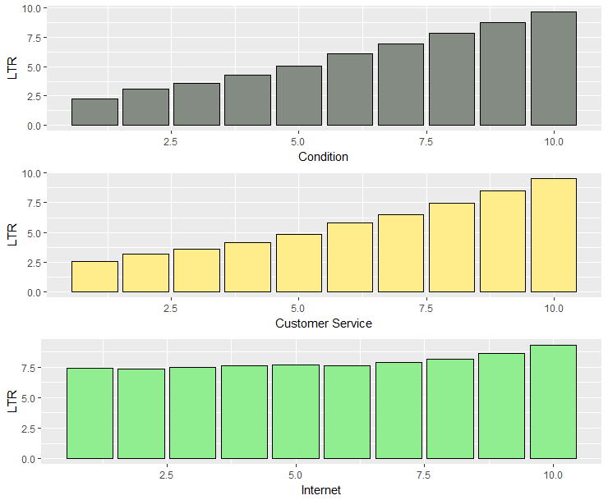
Analyzing Metrics

Slide 19
Linear Modeling with Metrics
Overall Satisfaction
Guest Room Satisfaction
Tranquility
Hotel Condition
Customer Service
Staff Cared Metric
Internet Satisfaction
Check in Satisfaction
Multiple Metrics

Slide 20
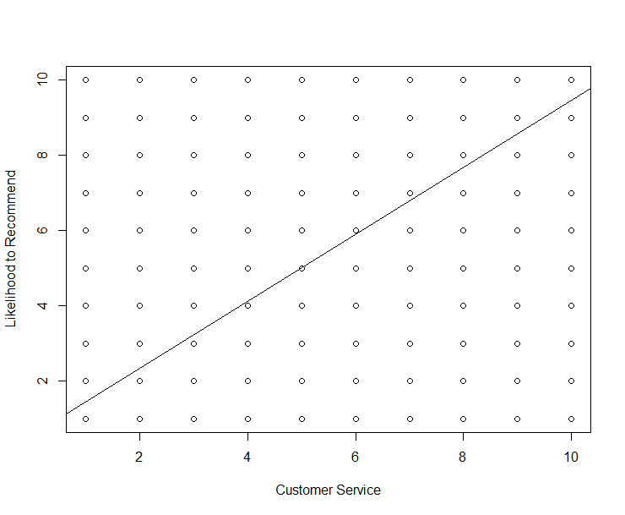
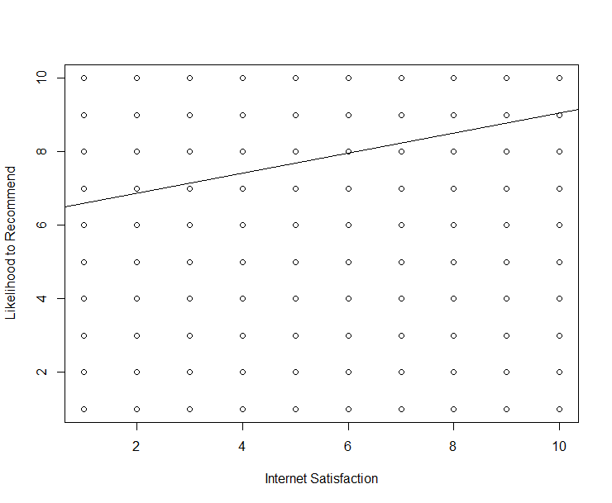
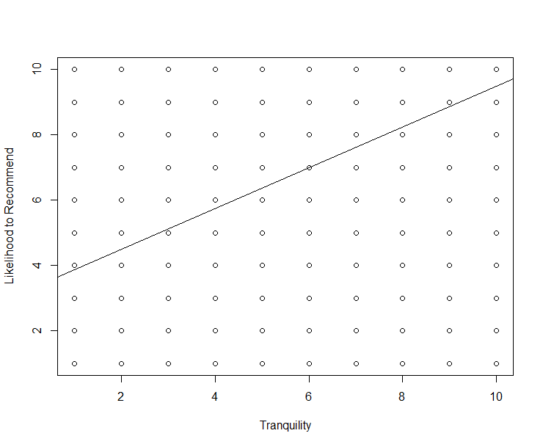
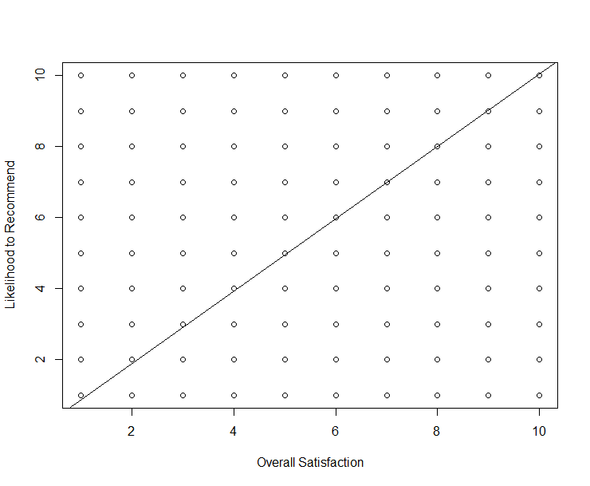
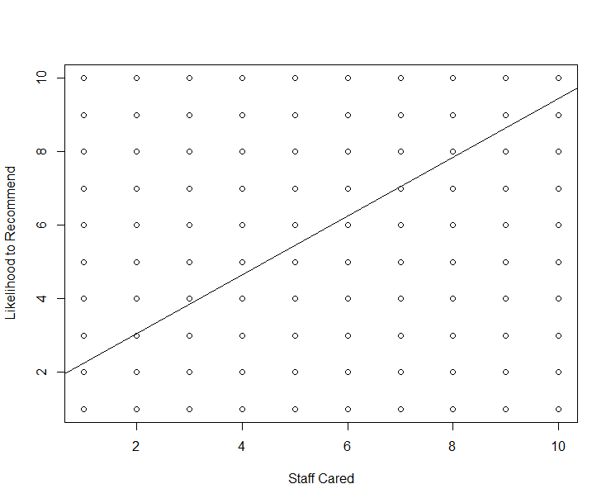
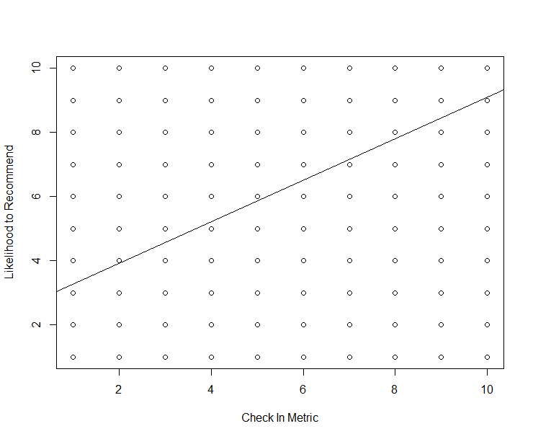
Linear Modeling with Metrics

Slide 21
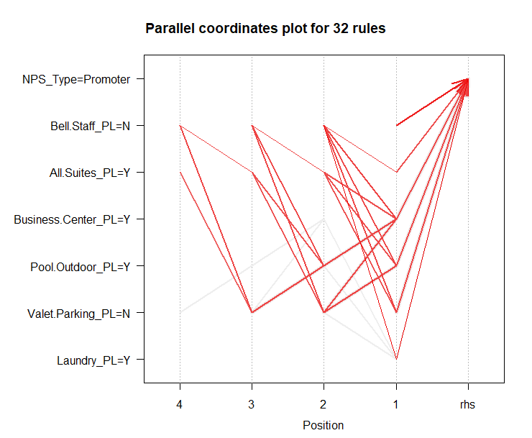
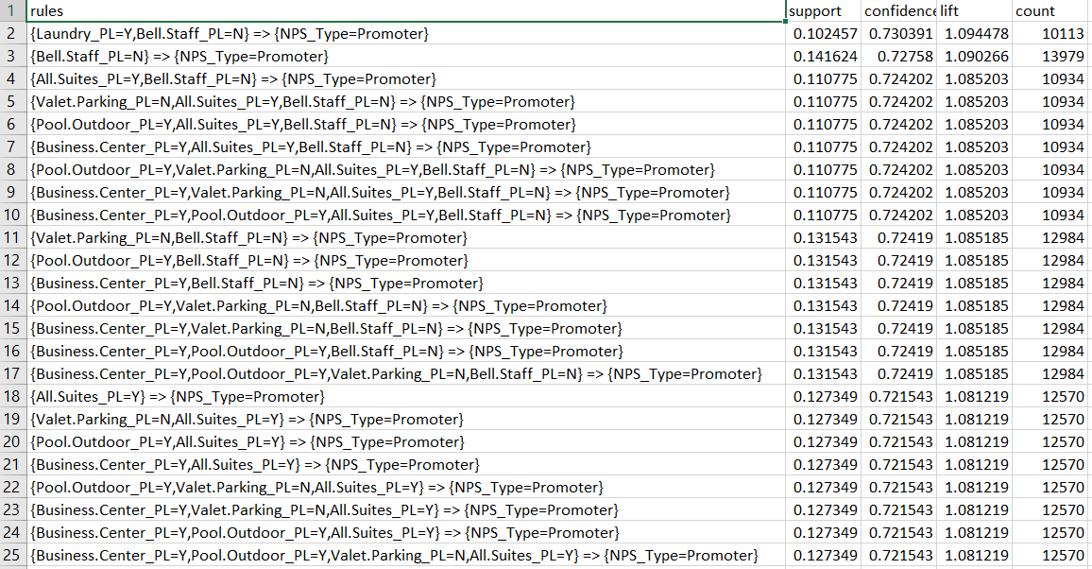
Association Rule Modeling

Slide 22
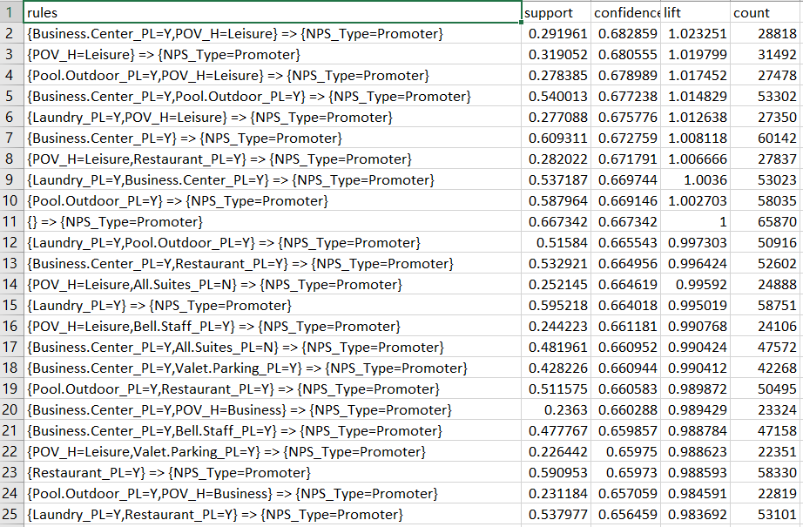
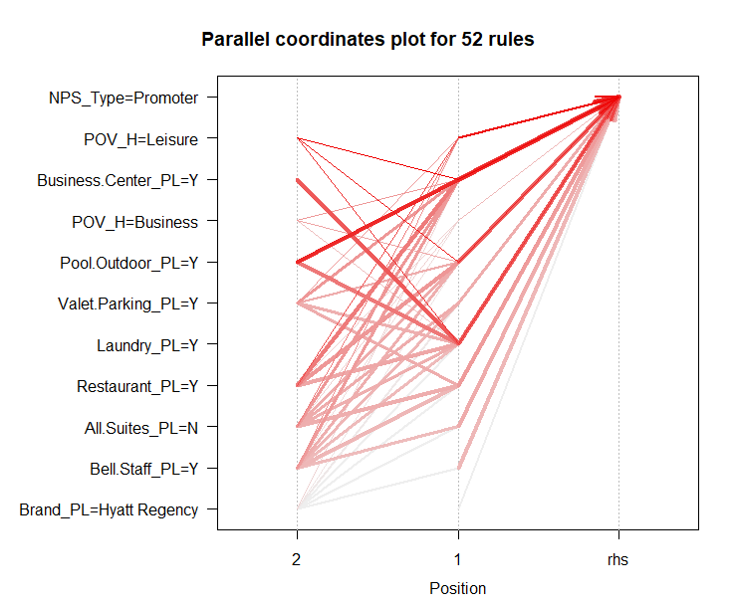
Association Rule Modeling

Slide 23
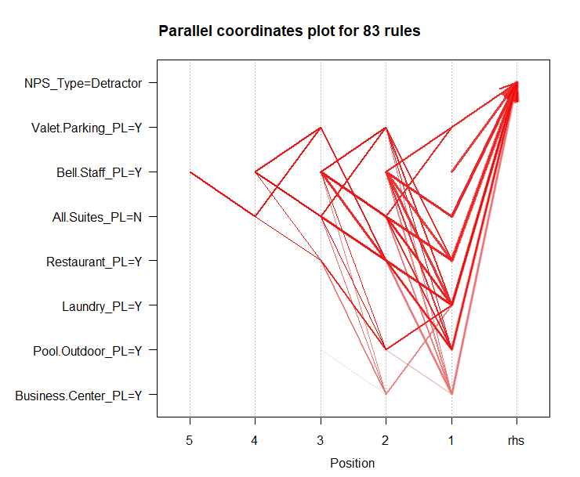
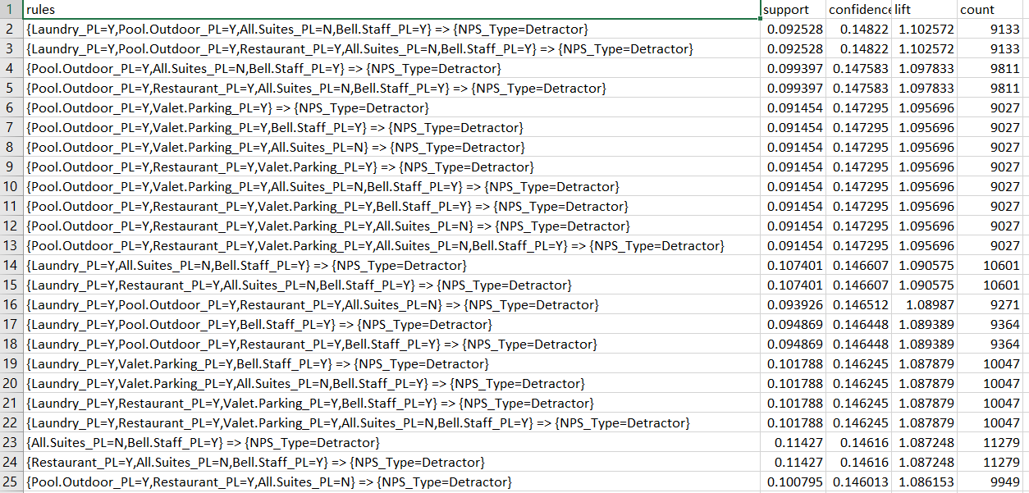
Association Rule Modeling

Slide 24
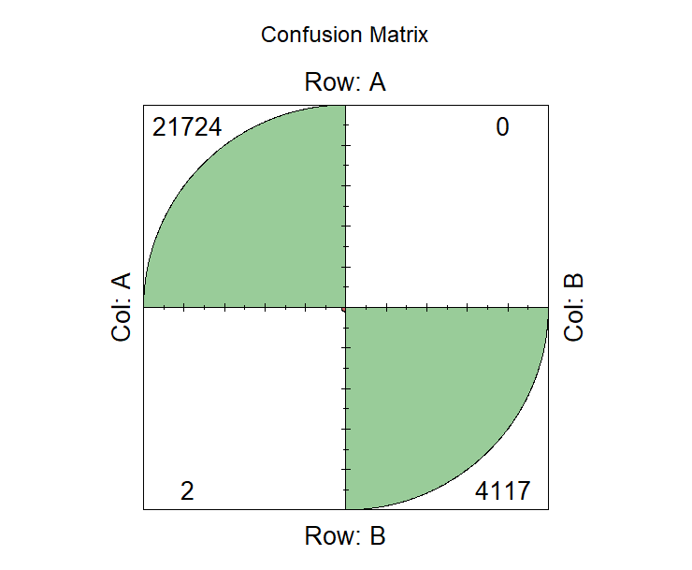
Predicting the likelihood to recommend of a customer: High, Medium or Low
This represents the no of times the SVM algorithm predicted the customer type correctly

Slide 25
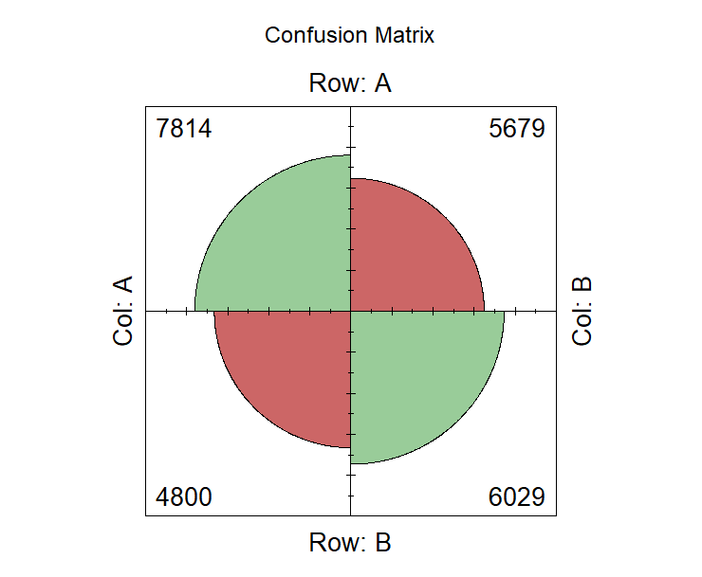
Predicting the Purpose of Visit of the Customer
This represents the no of times the SVM algorithm predicted the purpose of visit of a guest correctly

Slide 26
Thanks!
Questions?

